Slide 1

CSS Box Model

Slide 2
What is the Box Model?
The box model is a tool we use to understand how our content will be displayed on a web page.
Each XHTML element appearing on our page takes up a "box" or "container" of space.
Each box size is affected not only by content but also by padding, borders, and margins.
By knowing how to calculate the dimensions of each box, we can accurately predict how elements will lay out on the screen.
As we build a new page, we can arrange these boxes on the screen, creating a balanced layout with white space around the content.
The importance of the box model concept cannot be overemphasized. It would be difficult and frustrating to create a website without understanding this concept.

Slide 3
Box Components
Each element on the page has the following components:
Margin
Border
Padding
Content
The easiest way to understand these components is to use one of the most versatile tools available to us as web designers: the <div> element.

Slide 4
Introducing the <div> Element
The <div> ("division") element groups other elements on the screen.
By setting the width and height attributes via CSS, we can reserve a precise amount of space on our page for specific content.
The actual content is nested and contained within the opening <div> and closing </div> tags.
When we apply CSS styling directly to the <div> element, all the elements contained within that <div> will inherit that style.
By using multiple <div> elements as building blocks, we can design an entire web page layout.

Slide 5
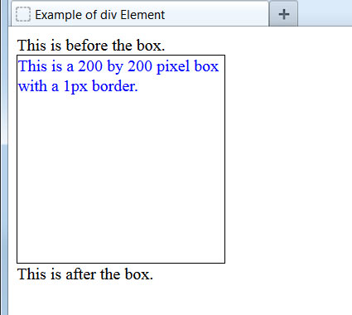
Example <div> Element
Let's create a box on the screen and add a border around it:
<style type="text/css">
.box200 {
width: 200px;
height: 200px;
border: 1px solid black;
color: blue;
}
</style>
...
This is before the box.
<div class="box200">
This is a 200 by 200 pixel box with a 1px border.
</div>
This is after the box.
...
With the border set, we can see the exact space taken up on the page.
Notice that there is almost no space separating the text from the box border. Elements such as paragraphs, headers, and lists automatically insert padding and margins, but plain text does not do so.

Slide 6
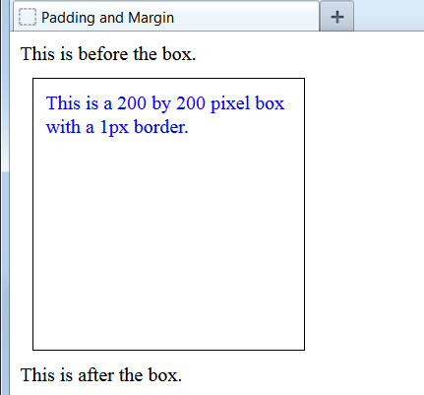
Adding Padding and Margin
Let's create some space between elements by adding both padding and margin:
<style type="text/css">
.box200 {
width: 200px;
height: 200px;
border: 1px solid black;
color: blue;
padding: 10px;
margin: 10px;
}
</style>
...
The 10 pixel padding adds buffer space, on all four sides, between the content and border. The 10 pixel margin adds buffer space, on all four sides, between the border and surrounding elements.
Let's examine this a bit closer up to see exactly what is happening.

Slide 7
Padding and Margin Illustrated
The dotted red line shows the margin's outer boundary and the dotted green line shows the padding's inner boundary.
242px high
When we define the width and height of a <div> element, these dimensions apply only to the actual content, not to the padding, border, or margin.
242px wide

Slide 8
Calculating Total Dimensions
When we are planning our page, we have to calculate exactly how much screen space a <div> or any other element will use. The formula is:
Total element width = defined width + left padding + right padding + left border + right border + left margin + right margin.
Total element height = defined height + top padding + bottom padding + top border + bottom border + top margin + bottom margin.
In our previous example:
Total <div> width = 200px + 10px + 10px + 1px + 1px + 10px + 10px = 242px.
Total <div> height = 200px + 10px + 10px + 1px + 1px + 10px + 10px = 242px.
Padding, borders, and margins do not have to be the same on all four sides, as they are in this example. Let's see how to set these individually.

Slide 9
Setting Individual Margins
We can set the specific margin sizes by using these four properties:
margin-top:
margin-right:
margin-bottom:
margin-left:
In practice, few web designers use these properties, preferring a shorthand method that condenses the declaration to a single line:
margin: 10px;
Sets all four margins to be 10px.
Sets the top and bottom margins as 10px and the left and right margins as 5px.
margin: 10px 5px;
Sets the top margin as 20px, the right margin as 10px, the bottom margin as 5px, and the left margin as 15px.
margin: 20px 10px 5px 15px;

Slide 10
Setting Individual Padding
We can set specific padding sizes by using these four properties:
padding-top:
padding-right:
padding-bottom:
padding-left:
Again, these are rarely used. Instead, the same shorthand method is employed:
padding: 5px;
Sets padding as 5px on all four sides.
Sets top and bottom padding as 25px and left and right padding as 5px.
padding: 25px 5px;
Sets top padding as 50px, right padding as 10px, bottom padding as 15px, and the left padding as 5px.
padding: 50px 10px 15px 5px;

Slide 11
Setting Individual Borders
Customizing borders is more involved. Since they are visible on the page, we have to specify style, thickness, and color. Accordingly, there are more properties available:
border-top-width:
border-right-width:
border-bottom-width:
border-left-width:
border-top-style:
border-right-style:
border-bottom-style:
border-left-style:
border-top-color:
border-right-color:
border-bottom-color:
border-left-color:
To make things easier, we can use the shorthand method as before:
border-width: 10px;
border-style: solid dashed;
border-color: blue red orange gray;
If the three border properties will be identical on all four sides, we can use a single-line border shorthand, as we did in an earlier lesson:
border: 5px solid blue;

Slide 12
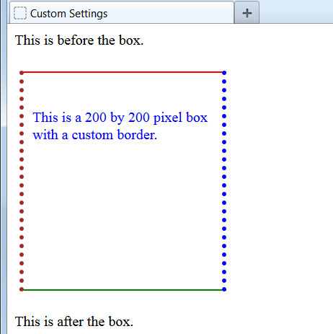

Example of Customized Settings
Here we have set custom padding, borders, and margins:
<style type="text/css">
.box200 {
width: 200px;
height: 200px;
color: blue;
padding: 40px 10px 0px 10px;
margin: 25px 5px;
border-width: 2px 5px;
border-style: solid dotted;
border-color: red blue green maroon;
}
</style>
A helpful way to remember the order of shorthand settings is that it
starts at noon and goes clockwise around: top, right, bottom, left.

Slide 13
Pixels vs. Percent:
The width property can be specified in pixels or in percent. By using "width:50%", we are telling the browser to make the width of the element exactly 50% of the space available.
Using percent instead of pixels can make our page layout highly flexible. For example, we can use the entire screen real estate, no matter what size screen or resolution our web visitor has.

Slide 14
A technique to center a <div>:
Because we don't know what the screen resolution will be for our visitors, it can be challenging to get our pages to display attractively for all viewers.
A useful technique is to set the right and left margins of a <div> to the value "auto". This tells the browser to maintain an equal distance on the right and left, effectively centering the <div> no matter how wide the available area is:
.centerme {
margin:0 auto;
}
This same technique can be used on a <div> element that contains all your page content in order to center your page on the screen, no matter what the screen resolution of your web visitor.

